Slide 1


Hii,
Iam Siddhika
Welcome to Power BI Series
Part -61

Slide 2




I’m very excited to dive into this with you all!
Are you ready to enhance your data visualization skills?
We focus only on the most used and important Visuals
Today Content
VISUALIZING DATA
VISUALS - COMPARISON
COLUMN CHART BAR CHART
DIFFERENCE BETWEEN
STACKED AND CLUSTERED

Slide 3
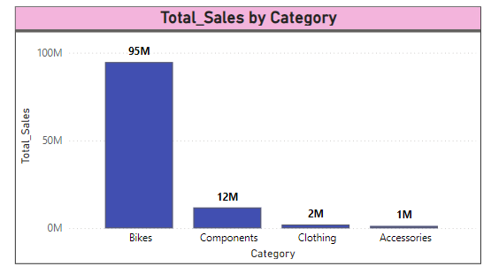


COLUMN CHART
Go and
explore
A Column Chart in Power BI displays data using vertical bars where the length of each bar represents the value of each category. This chart is ideal for comparing values across different categories.
formating of
Column
Visuals
When to Use: To compare data across discrete categories.
To show changes in data over time, particularly for a small number of time periods.
To highlight significant differences between categories.
Purpose: Column charts help visualize data in a way that makes it easy to compare different categories at a glance. They are particularly useful when you want to compare numerical values across distinct categories or show trends over time.

Slide 4
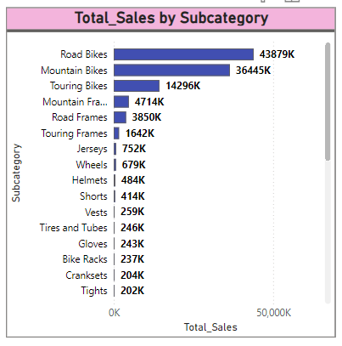


BAR CHART
Go and explore formating of Bar Visuals
A Bar Chart in Power BI displays data using horizontal bars where the length of each bar represents the value of each category. It is essentially a column chart rotated 90 degrees.
Purpose: Bar charts make it easy to compare values across different categories, especially when there are
many categories or the category names are lengthy. They provide a clear visual representation of data, making it easier to identify trends and differences.
When to Use: To compare data across discrete categories.
When category names are long and require more space.
To highlight differences in values across categories.

Slide 5
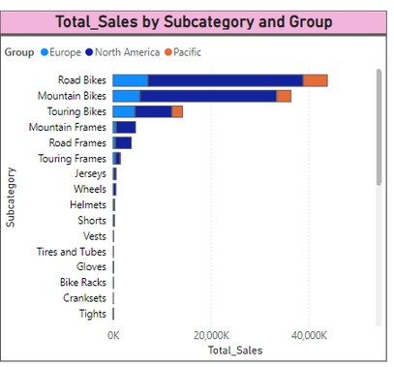
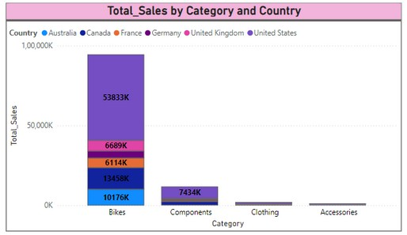

DIFFERENCE BETWEEN STACKED AND CLUSTERED
Stacked Column/Bar Chart
Why waiting just go and explore it?
Stacked Column Chart
Stacked Bar Chart
A Stacked Column or Bar Chart displays data with bars divided into segments that represent subcategories, stacking them on top of each other. This visual helps in comparing the total value across categories as well as the contribution of each subcategory to the total.

Slide 6
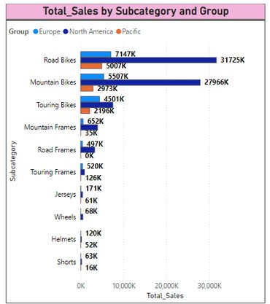
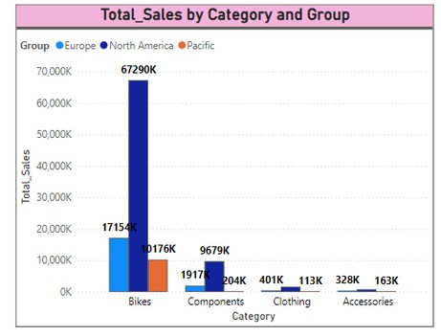
DIFFERENCE BETWEEN STACKED AND CLUSTERED
Clustered Column/Bar Chart
Why waiting just go and explore it?
Clustered Column Chart
Clustered Bar Chart
A Clustered Column or Bar Chart displays data with bars grouped by categories, with each bar representing a subcategory. This visual helps in comparing multiple subcategories within each main category.

Slide 7


Thank you for joining me today to learn about Part -61 of Power BI!
Remember, Effective data visualization is crucial for turning data into meaningful insights and compelling narratives with Power BI.
Stay tuned for more insights and tips on Power BI in our next Series.
Follow
Siddhika Shah

